Slide 1
Leveraging Portal Technology for Composite Dashboard Applications
September 15, 2005

Slide 2
Welcome & Introduction
Bruce Green, VP Development, Dashboard Engineering
John Ainsworth, VP Development, BPM Engineering

Slide 3
Agenda
A presentation and demonstration on how to use the latest CA Portal technology to build Composite Dashboard Applications.
This presentation will help you understand the following:
  What is a Composite Dashboard Application?
  Benefit of a Composite Application.
  What is CA’s Portal Technology?
  How CA’s Portal is already used within CA.
  An introduction to Portal r12?
  How internal adopters can take advantage of Portal r12?

Slide 4
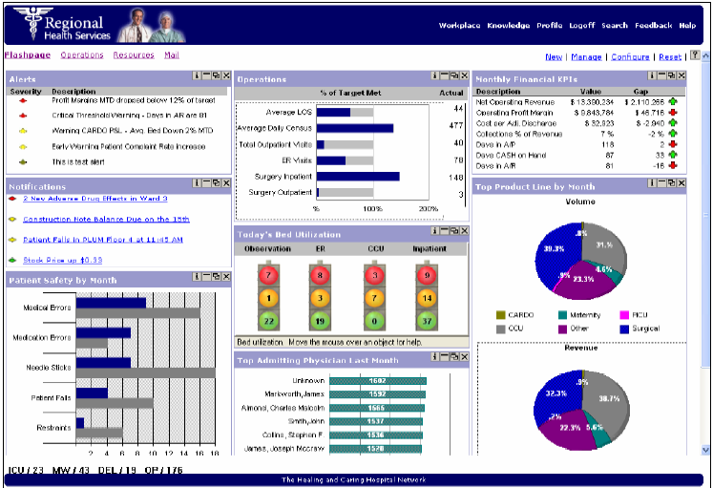
What is a Composite Dashboard Application?
Software that combines the elements of a business activity in a single coordinated application and user interface.

Slide 5
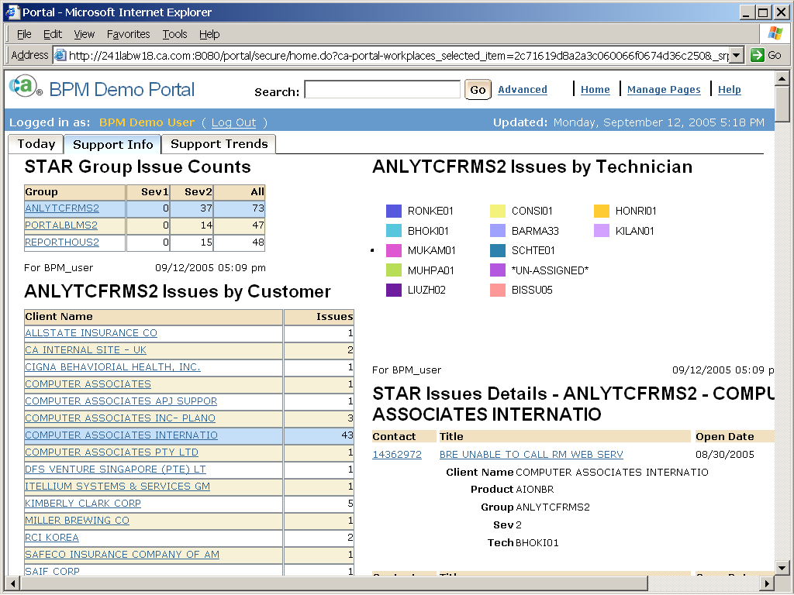
What is a Composite Dashboard Application?
It can also provide real-time access to all needed data feeds and control systems, with various facets of the program "talking" to one another in order to get a job done.

Slide 6




What is a Composite Dashboard Application?
When a composite application uses industry standards, it can work across all systems and networks: it's typically accessed through a Web browser so that any Internet-connected person can use it.

Slide 7
How it works.
The user sees a Web portal that combines the various applications needed to complete a business process.
It combines performance metrics with knowledge management, enterprise search, and online collaboration.
It provides the user a way to respond to events as they emerge across the business.

Slide 8
The goals.
Spare users the labor of having to use multiple applications to complete a given task.
Allow users to create their own dashboards, further enhancing productivity.
Right now dashboards are built by tech-savvy consultants or internal staff, but the aim is to put technology at the service of what people actually do by allowing applications to be broken up and recombined to suit any need.

Slide 9
Why they’re important
Composite applications can boost productivity, save money, and improve operations.
They're also speedy to build and maintain. A typical composite-applications project is currently measured in weeks, a sharp contrast to custom applications that typically take 12 to 18 months.
  E.g. CA TS integrators and clients can build, customize or extend product functionality without development (IT) assistance.

Slide 10
Why they’re important
Developing composite applications is far less expensive than more-traditional approaches to software development and implementation. In theory, training costs are almost nil, because the dashboard icons should reveal familiar or intuitive interfaces.
Other benefits include quick adaptations to changing business rules, less manual processing, and better leverage of existing systems and resources.

Slide 11
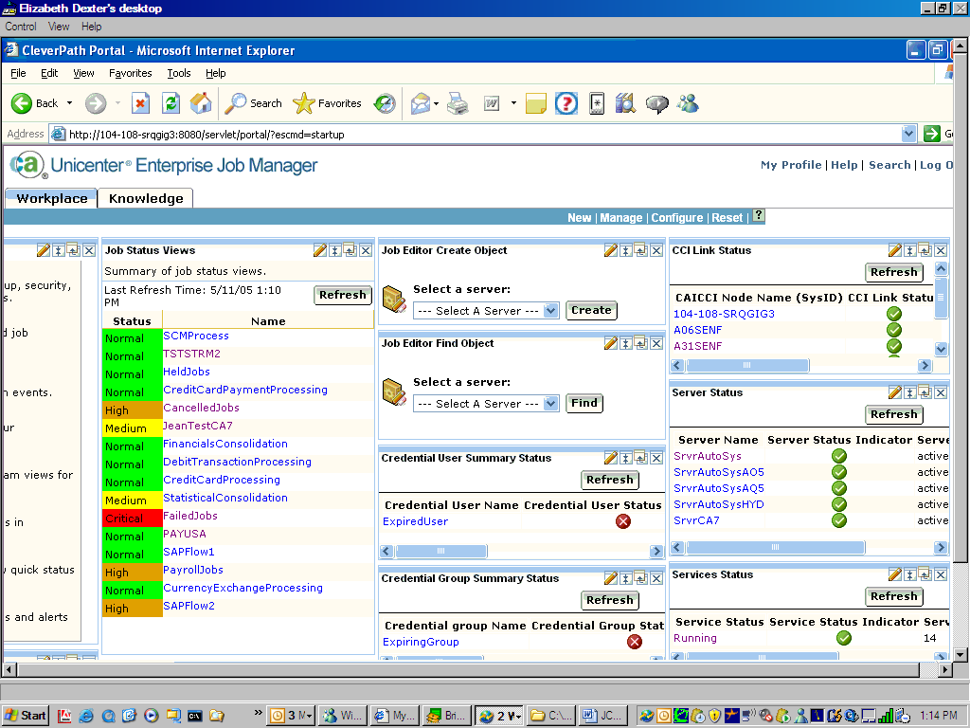
What does it mean to CA
Customers want a dashboard view of CA solutions. This has lead to brand versions of Portal.
  Unicenter Management Portal
  Security Command Center
  BrightStor Management Portal

Slide 12
The challenge for CA.
Common service – provide Portal technology.
Business Units – create dashboard style views of their solutions.

Slide 13
CA’s Portal
An application and framework for creating Composite Dashboard applications.
It’s sold externally as an application – CleverPath Portal.
It’s available internally as a framework – Portal Embedding Kit.
The current GA version is Portal 4.7.
The next version is Portal r12 and is scheduled for Beta this fall.

Slide 14
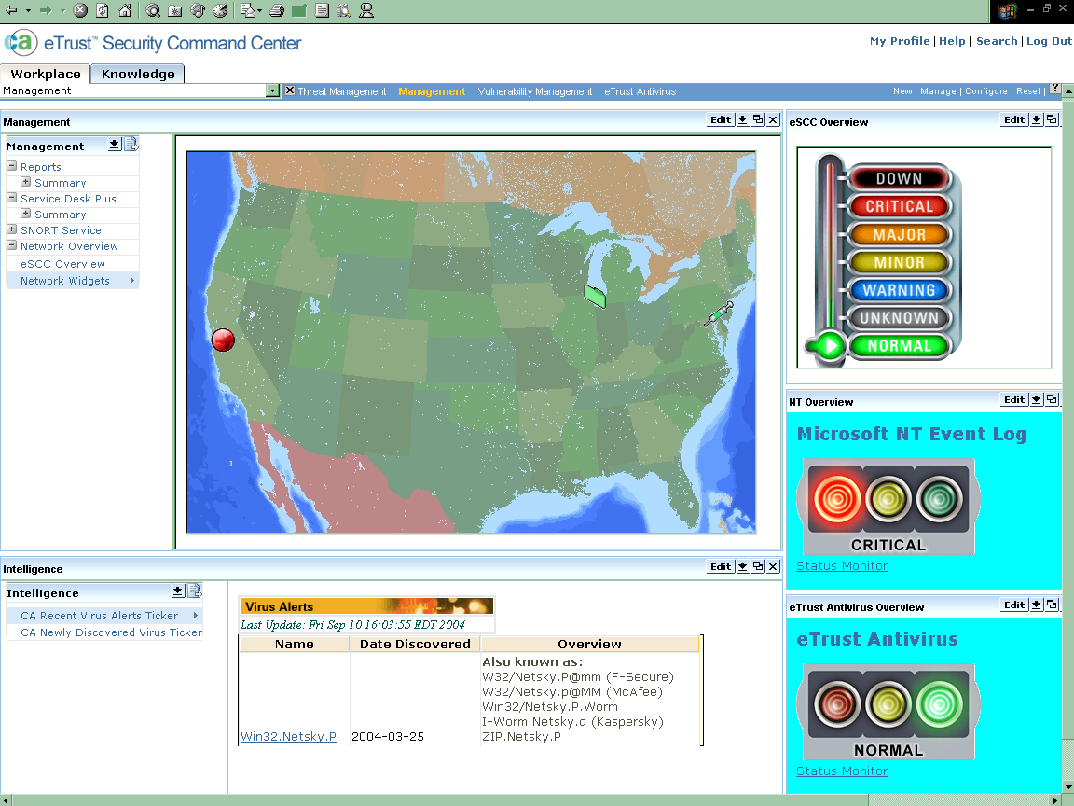
eTrust SCC (aka Portal 4.x)
Notes:
eTrust Security Command Center is a powerful Security Information Management solution that solves “security information overload” by monitoring and managing all aspects of enterprise security — from discovery to resolution — in real time. eTrust Security Command Center gathers business intelligence by aggregating, reducing, correlating and prioritizing disparate security data from security devices, software technologies and assets across an organization. It then converts and prioritizes this large volume of data into intelligent, actionable information that can be managed from a single, centralized console. Finally, eTrust Security Command Center displays this data in an understandable, visual format that represents the information in context to an organization’s business priorities. The solution’s centralized command and control console and alerting features let organizations quickly take action and remediate threats, decreasing the risk of critical business systems being compromised, minimizing downtime and helping to ensure business continuity. In addition, eTrust Security Command Center provides the tools to complete a post-event investigation — allowing organizations to retrace the steps of a security incident or audit their security for compliance needs.

Slide 15
Portal r12
The goals remain the same.
A greater focus on providing a flexible and reusable framework. It provides a series of ways in which it can be used.
Significantly updated to take advantages of improvements in the underlying technology and the emergence of many new industry standards.

Slide 16
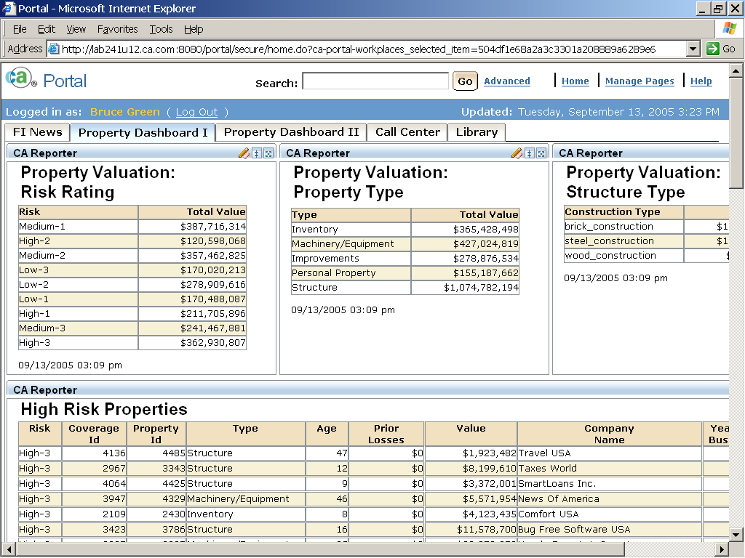
Portal r12

Slide 17
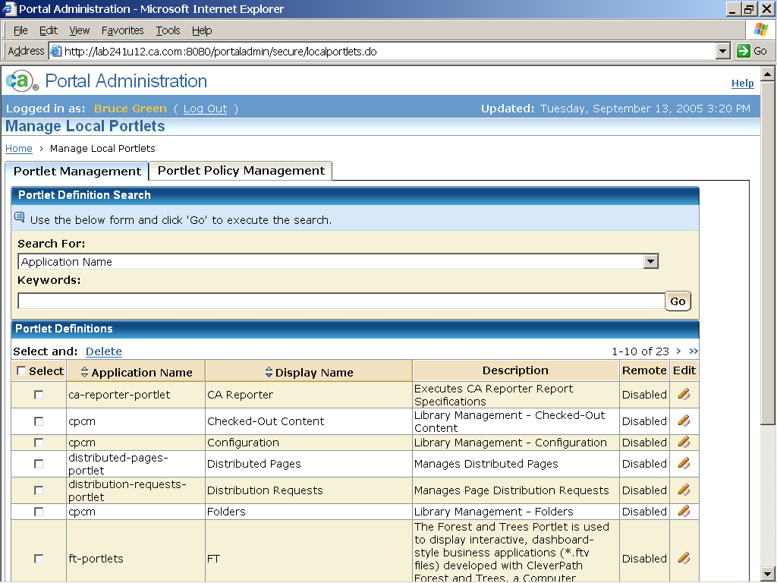
Portal r12 Administration

Slide 18
Portal r12 - Architecture, Standards, Best Practices
Tiered, Web framework
  Standards enable performance, scalability, reliability, availability, maintainability, manageability, security
J2EE application standards
  JAAS, JSP, EJB, JCA, JSP, RMI
User management and security externalized
  Embedded eTrust Identity Toolkit (eIAM)
Portlet standards
  Portable Java Portlets (JSR-168)
  Remote Portlets (WSRP)

Slide 19
Portal r12 - Architecture, Standards, Best Practices
Standard access to documents and content
  Java Content Repository API (JSR-170)
  WebDAV
User centric design
TAU common components
Tag libraries for portal components
  Portlets can be placed on any page in any position
JSP Model 2 architecture (MVC) via Apache Struts/Tiles

Slide 20
How to Leverage Portal r12
Use the basic web application framework.
You get:
  TechStack r4 integration
  TAU common components
  J2EE application with a JSP Model 2
  architecture (MVC)
  eIAM (toolkit) integration

Slide 21
User Management and Security
Integrate with corporate user management systems
Leverage CA eTrust and security experience
Java Authentication and Authorization Service (JAAS)
for interoperability and extensibility
Externalized user management model works with:
  Default embedded user management system
  LDAP systems
    eTrust Admin
    MS Active Directory
    Novell eDirectory
    others
More comprehensive permission model

Slide 22
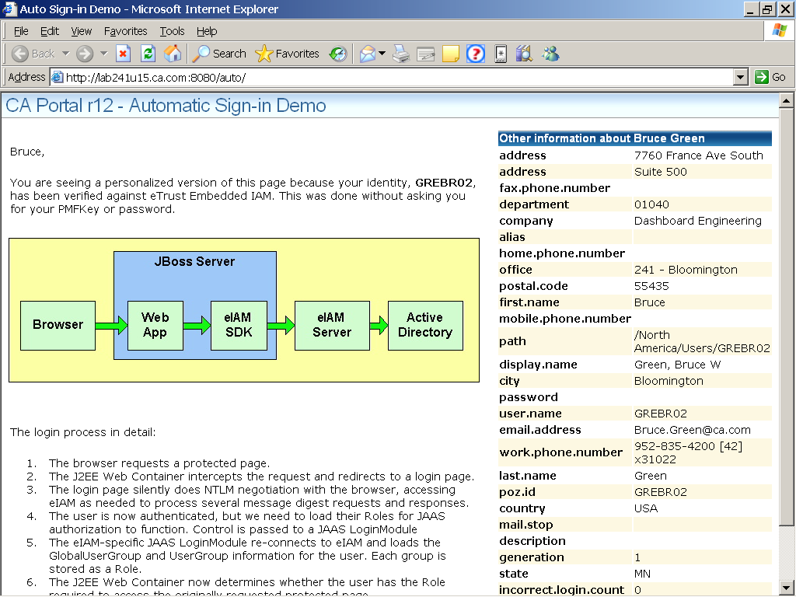
User Management and Security

Slide 23
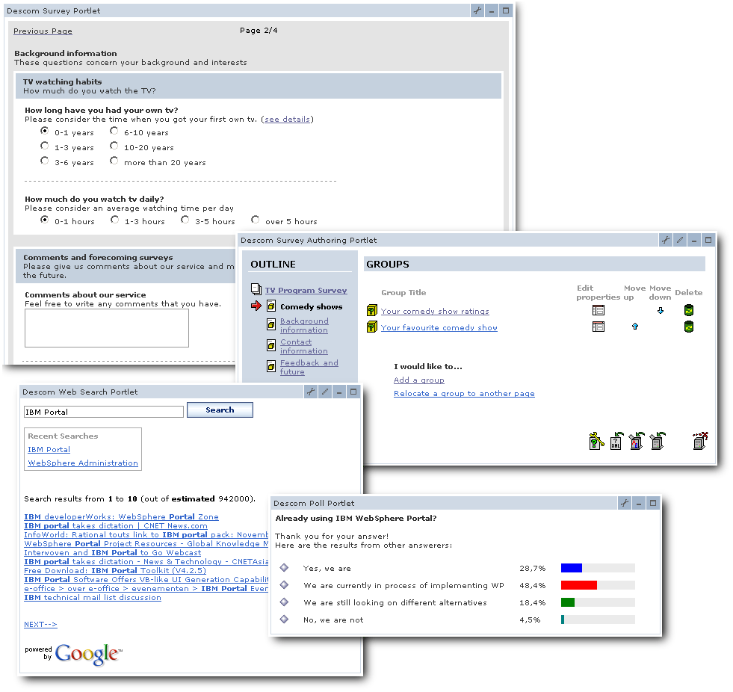
How to Leverage Portal r12
Use portlets to provide UI component and dashboard capabilities.

Slide 24
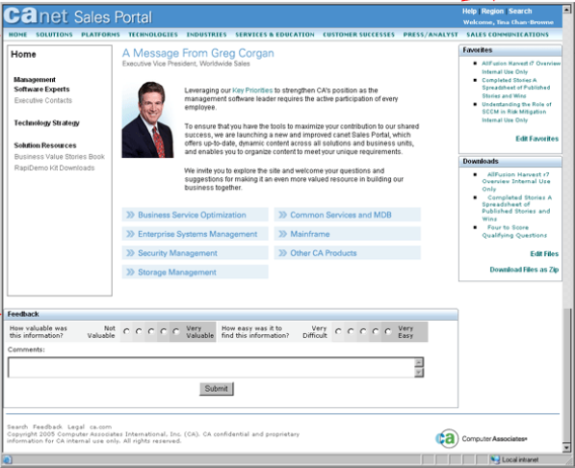
canet Sales Portal Uses Portal r12
JBoss (J2EE)
eIAM (toolkit)
Struts/Tiles
JSP
JSR 168 Portlets

Slide 25
Powerful Portlets
The Java Portlet API and the Web Services for Remote Portlet (WSRP) standards enable interoperability of portal servers, local portlets, and remote, visual, user-facing web services, respectively.
The ultimate goal of these standards is to make available a large number of portlets that can be run on any compliant portal server locally, as well as remote WSRP services that plug and play with all compliant portal servers.
This will facilitate a portal component market in which a large variety of application providers, ISVs, and the open source community offer readily available portlets or visual web services.

Slide 26
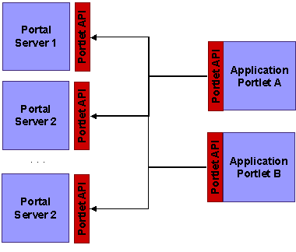

Java Portlet API (JSR 168)
The Java Portlet API establishes interoperability between portlets and portals.
All portlets written to the Portlet API will run on all compliant portal servers such a CA’s Portal.
Think about building portlets and content – not just complete applications.

Slide 27
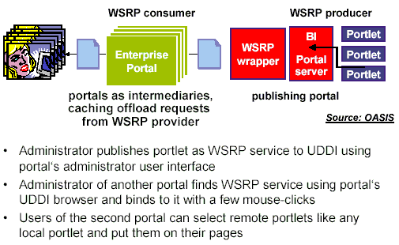
Web Services for Remote Portals (WSRP)
A web services protocol for aggregating content and interactive web applications from remote sources
CA’s portal can act as a WSRP producer for any deployed JSR-168 portlet

Slide 28
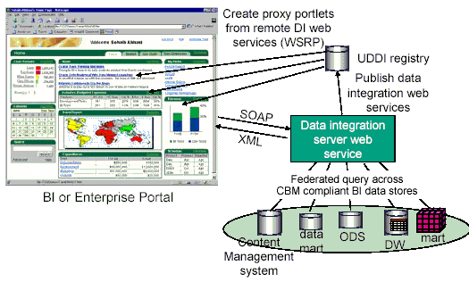
WSRP Example - Consumer
Several BI vendors such as SAS, MicroStrategy, and Cognos have announced web services support in their products to allow their BI tools and also BI objects such as reports, cubes, mining models etc. to be published as web services.

Slide 29
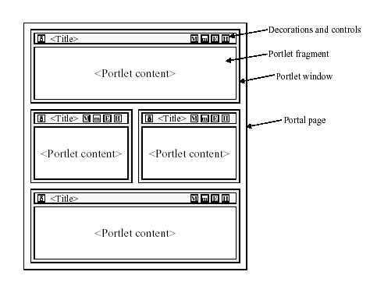
Remote Portlet
Remote Portlet
Remote Portlet
Remote Portlet
Web Service
Web Service
Web Service
Web Service

Slide 30
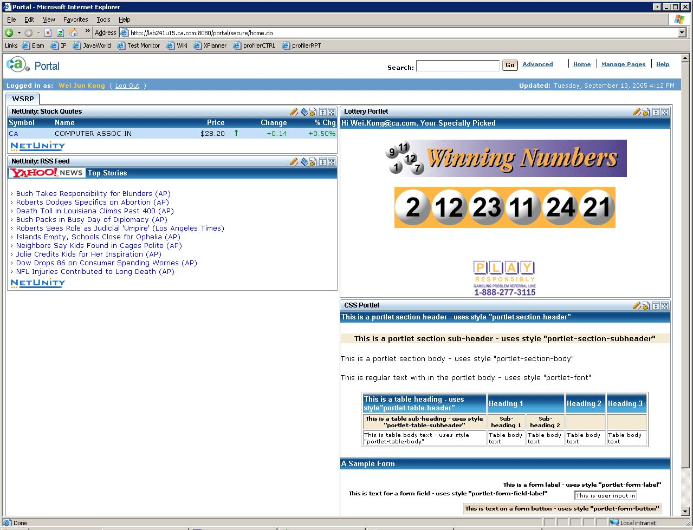
WSRP Portlets

Slide 31
Relationship between Portal & Portlets
HTTP
HTML, WML, VoiceXML, ..
Portal
Implementation
Portlet API
Local
Portlets
Generic
Portlet
Proxies
WSRP
/SOAP
Web
Services
for
Remote
Portals
Web Services
platform, or
Portal publishing
portlets
Service
Specific
Portlets
SOAP
Web
Services
Web Services
platform
Publish / Find Web Services (SOAP)
UDDI

Slide 32
Leveraging Portlets
Use existing portlets
  URL
  RSS
  Reporter
Create your own JSR 168 portlets
  Create various views into your technology via API’s and services
Create WSRP portlets to improve performance and functionality by moving process closer to the source.
Use inter-portlet communication to create interactive pages.

Slide 33
How to Leverage Portal r12
Use the Portal r12 page creation tools to build and distribute dashboard pages.

Slide 34
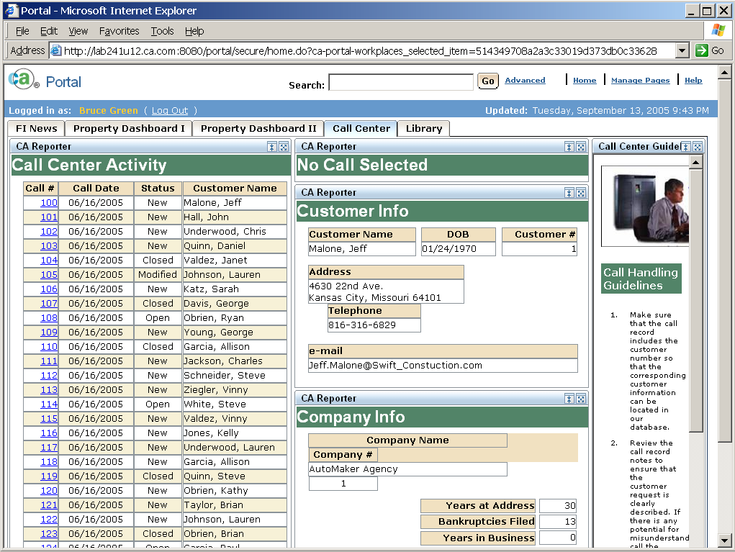
Portal r12 Pages

Slide 35
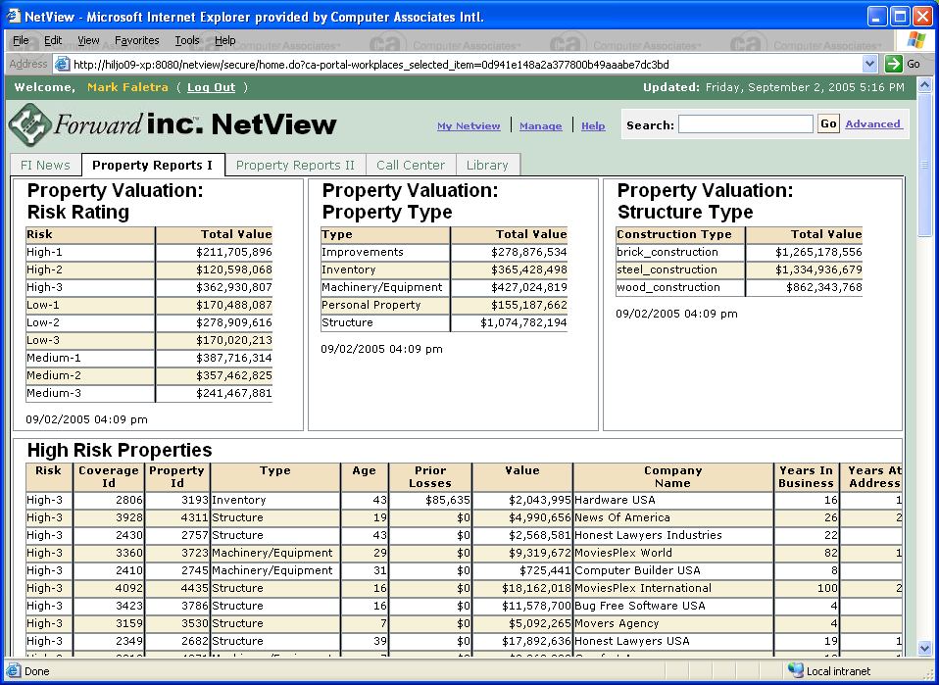
Portal r12 Pages

Slide 36
Leveraging Dashboard Pages
Pages can be created without any coding using existing portlets and content.
The page creation tools are designed for use by a “power user” vs. “programmer”.
Users can create their own Dashboard pages.
You can provide prepackaged Dashboard pages.
A page distribution process manages the publishing of pages to users.

Slide 37
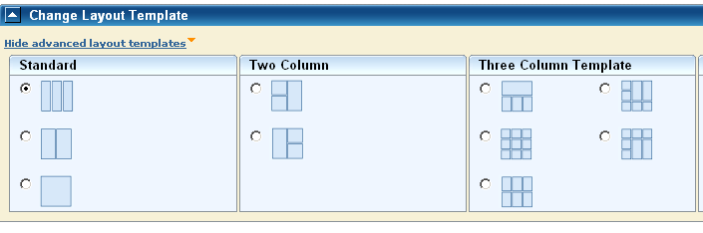
Leveraging Dashboard Pages
Variety of page layouts is possible.
Numerous properties for controlling the portlet’s decoration.

Slide 38
Leveraging Content – Portal Library
Utilitize it for:
  Document content store
  Web page repository
  BLOB (Binary Large Object) store
Provides you with:
  Secure storage
  Versioning
  Access WebDAV protocol and Java Content Repository API (JSR 170)
  Industry leading search capabilities.

Slide 39
Leveraging Workflow
CA Portal leverages workflow for
  Integration with Portal Library (CPCM) using triggers
  Automates business processes such as:
    Content management approvals
    Shared page distribution
Other custom portal applications (yours) should provide the user a way to respond to events as they emerge across the business.
So don’t just think about dashboard views. Also consider how to provide Workflow actors that utilize your API’s and services.
Embedded workflow presentation on Oct 27th

Slide 40
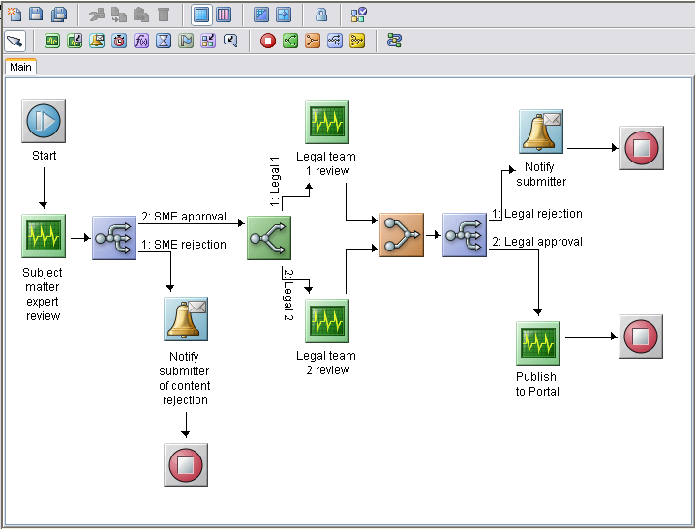

Slide 41
Portal r12 Walk Thru

Slide 42
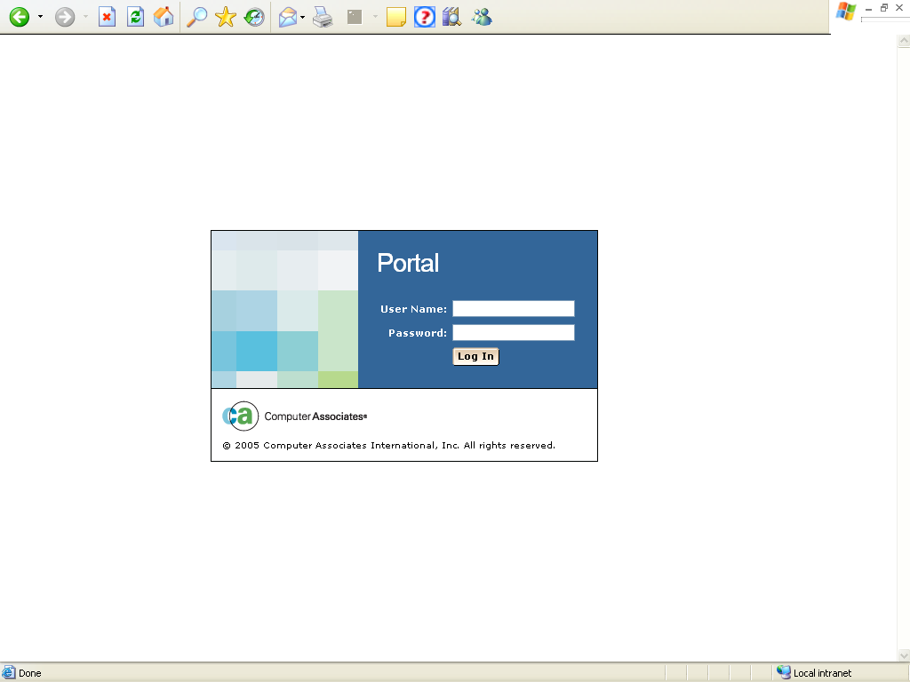

Slide 43


Slide 44
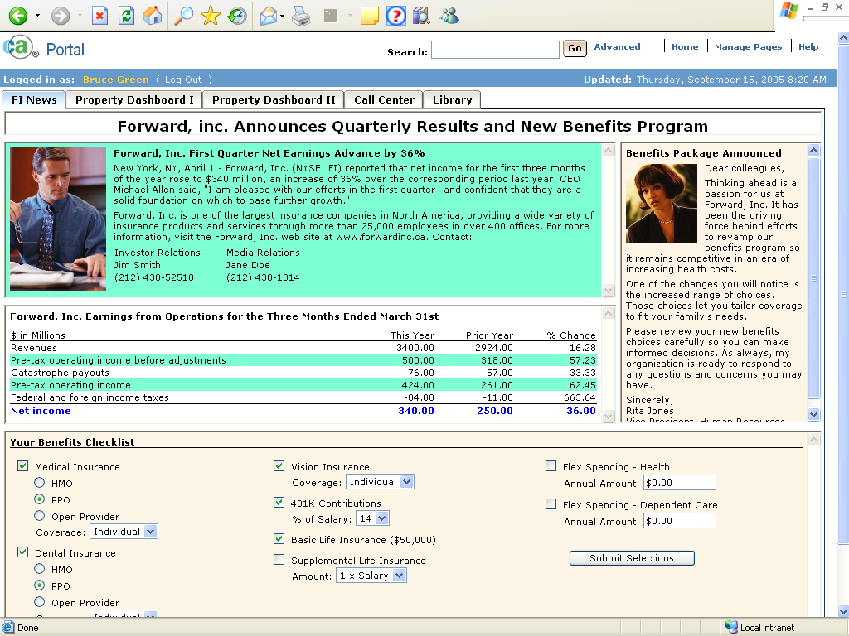

Slide 45
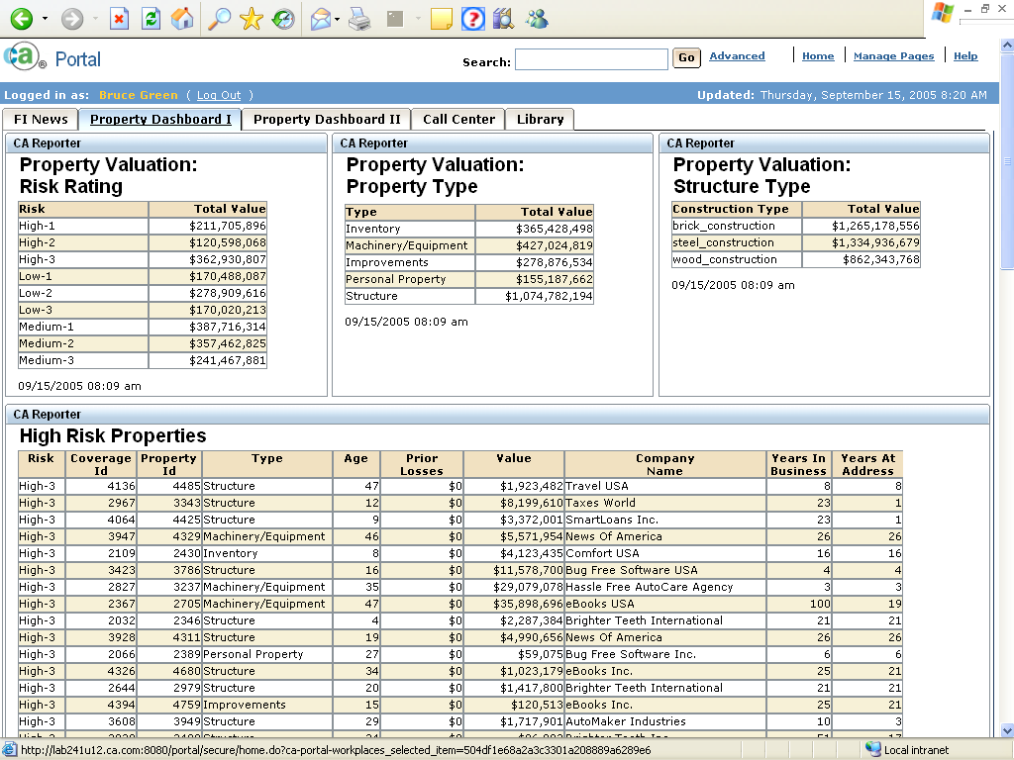

Slide 46
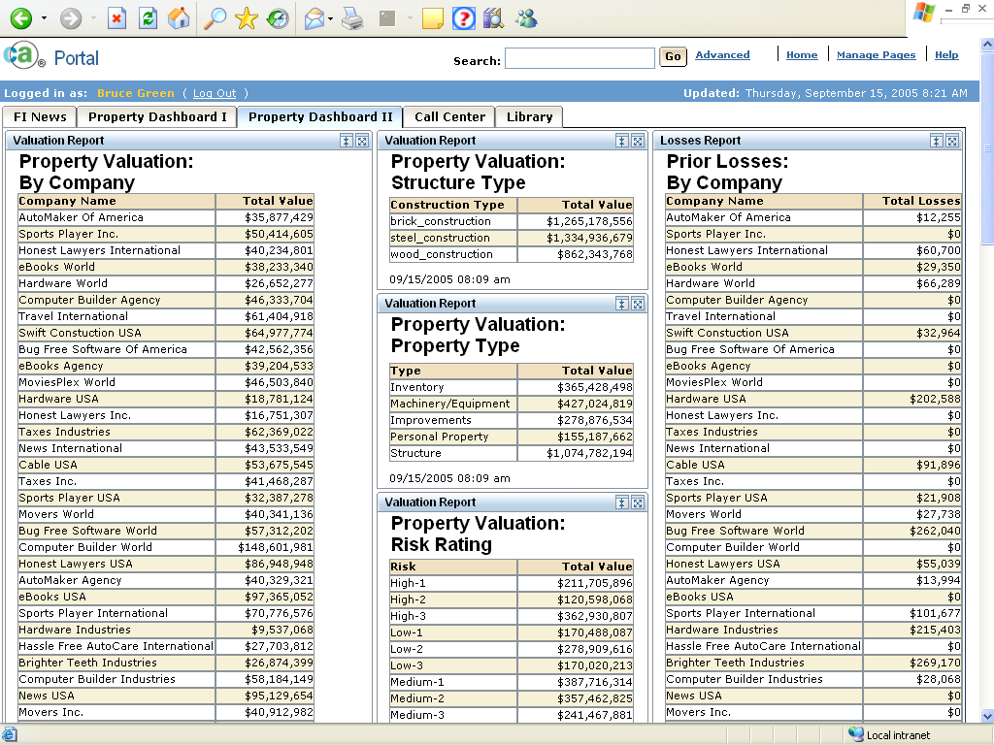

Slide 47
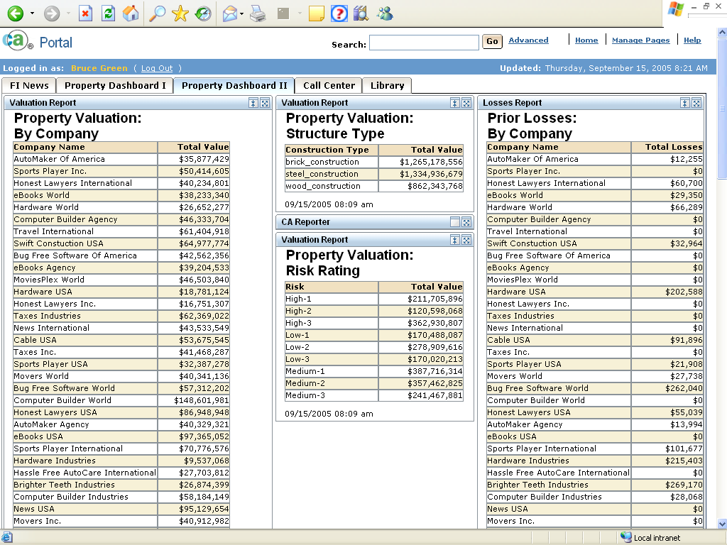

Slide 48


Slide 49
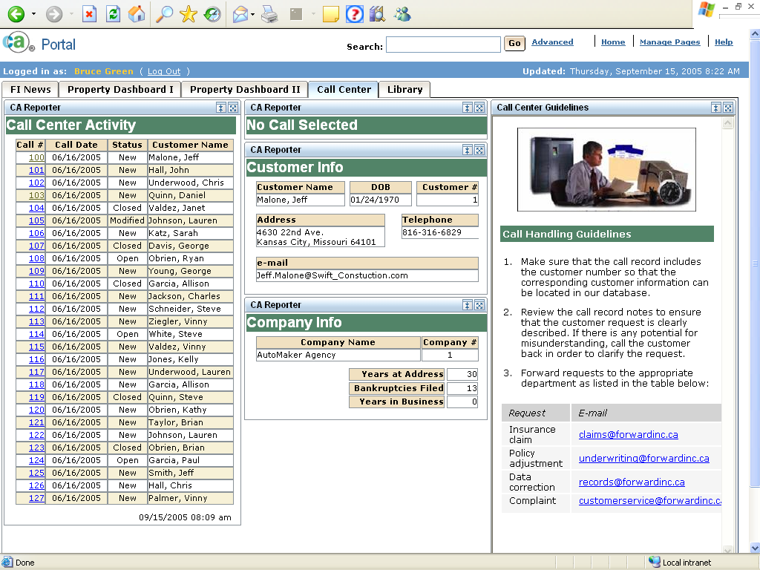

Slide 50
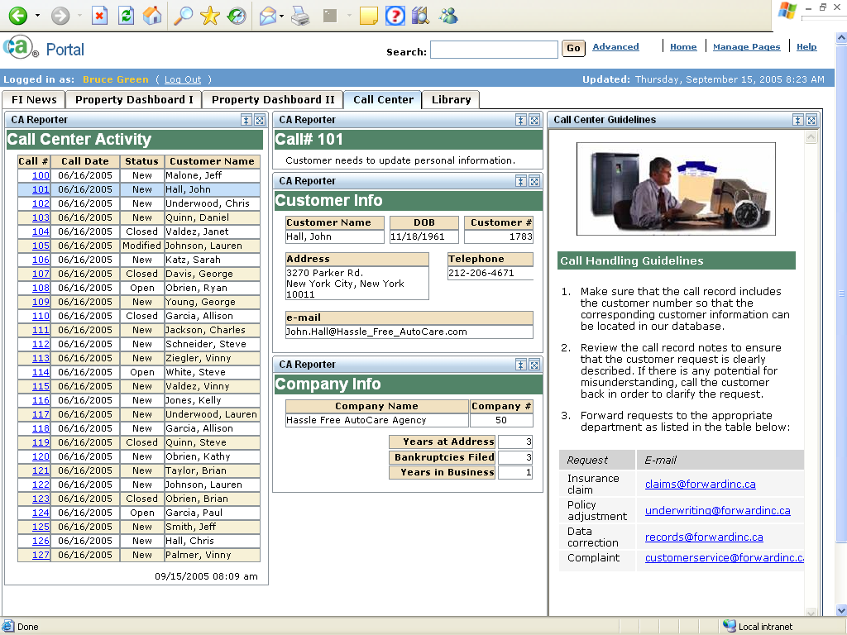

Slide 51
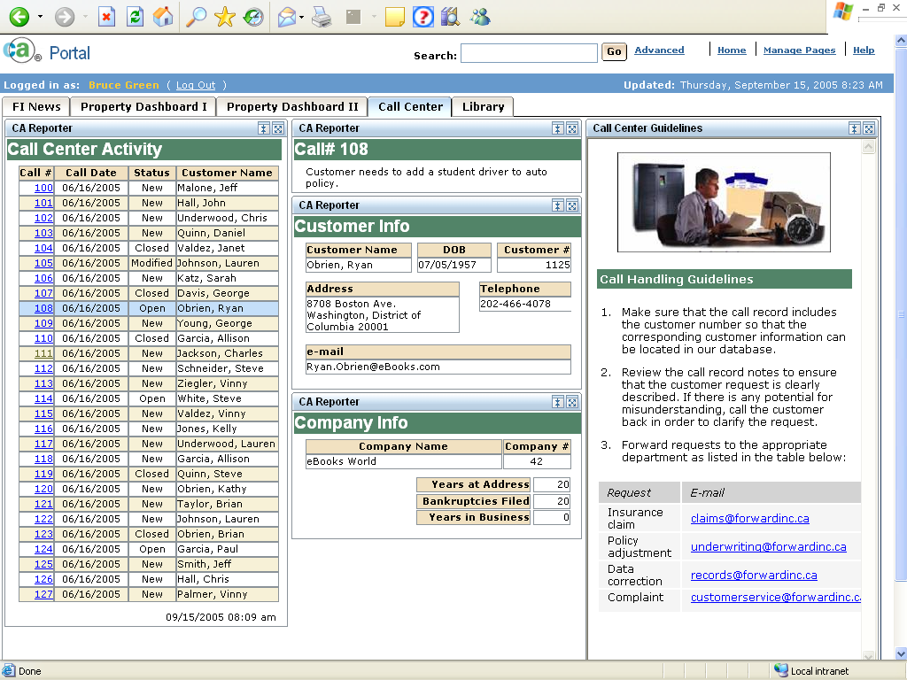

Slide 52
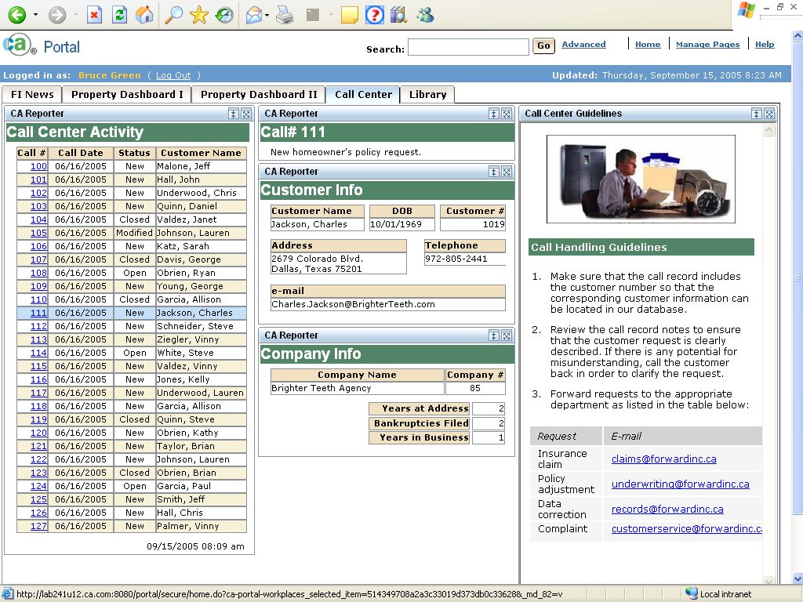

Slide 53
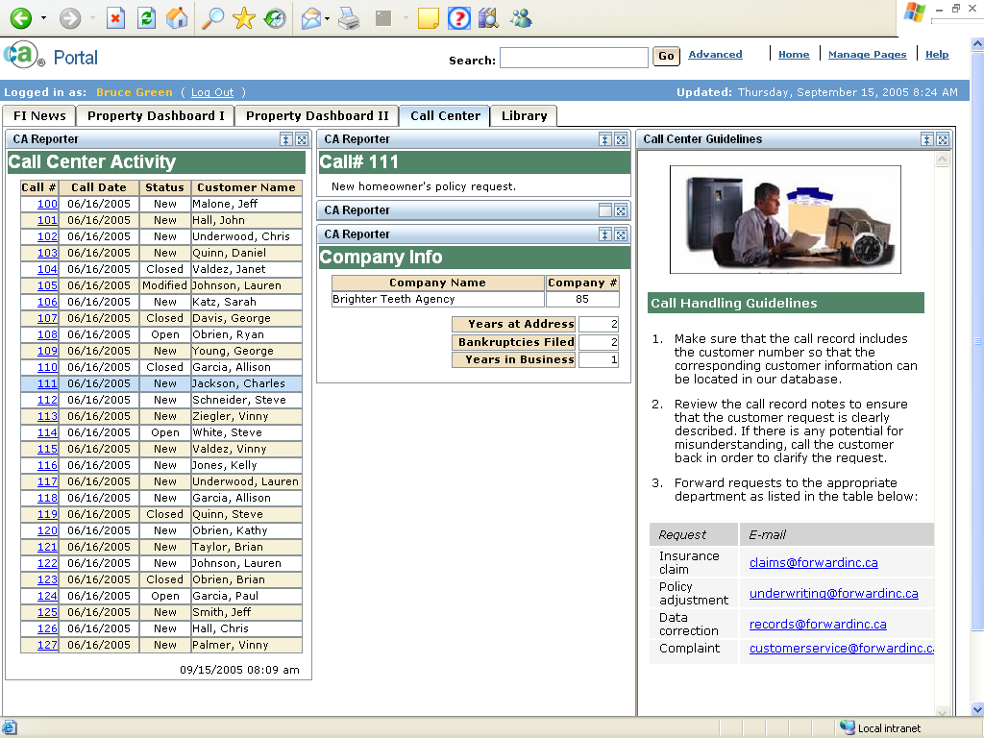

Slide 54
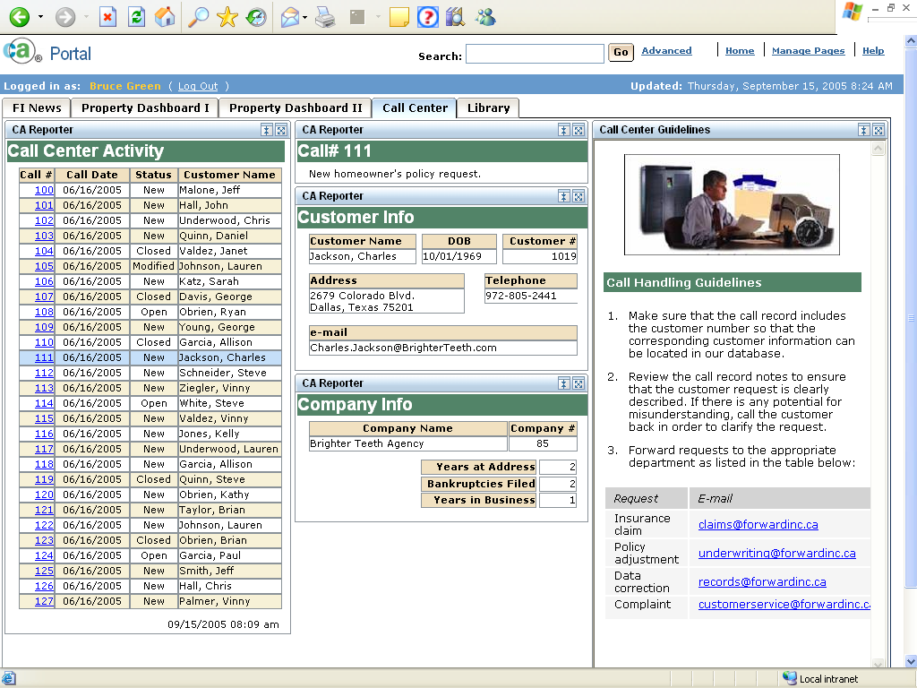

Slide 55
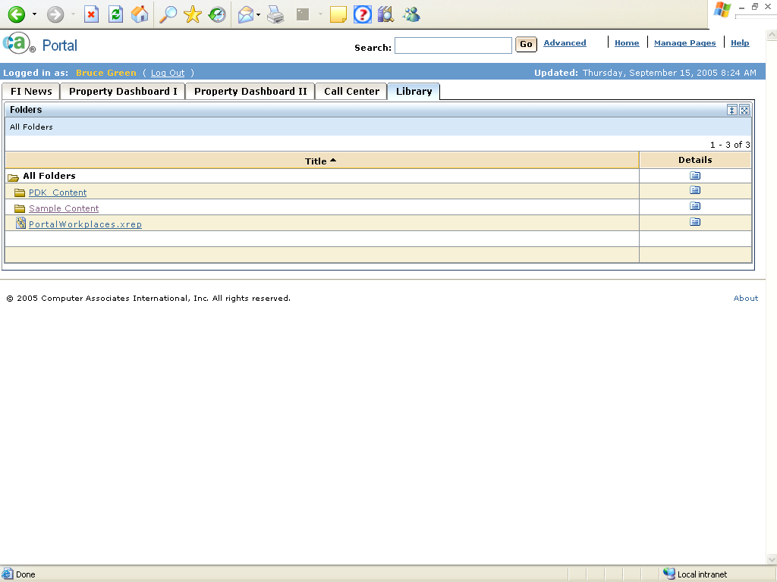

Slide 56
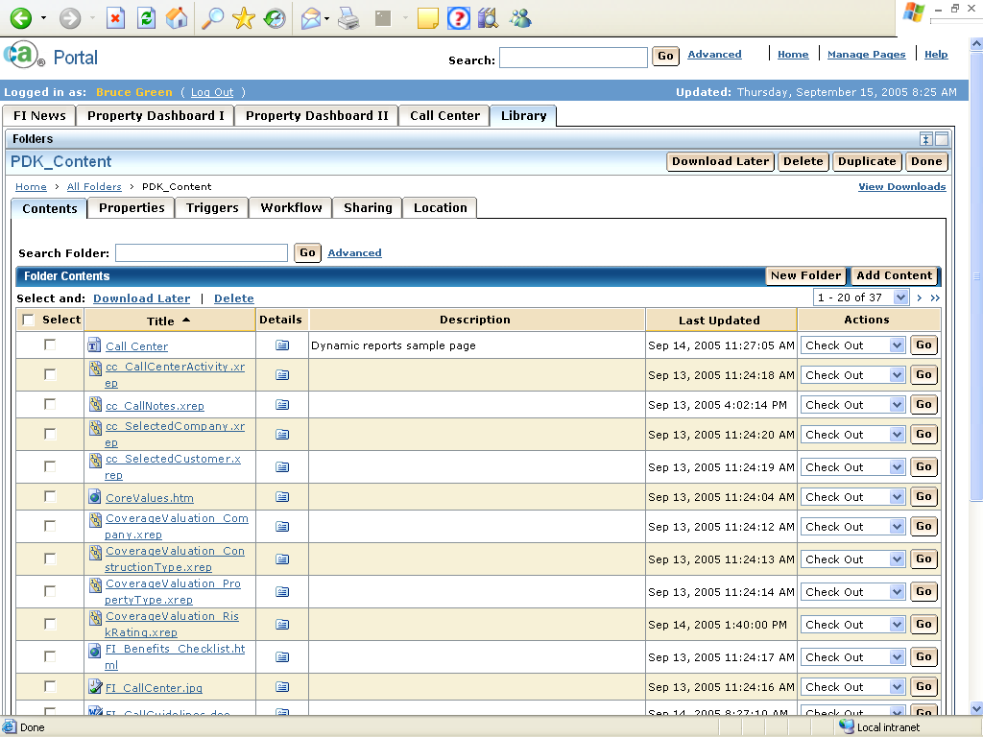

Slide 57
Summary / Conclusion
Customer are demanding dashboard style applications.
CA meets this demand with:
  Low cost, easy to use Portal.
  Standard portlets which expose critical data views and real-time access to CA solutions.

